Slide 1
Summer Term 22 Multi-Agent Reinforcement Learning for Self-Adaptive Systems Lecture-5: Multi-Agent RL Overview
Prof. Dr. Holger Giese (holger.giese@hpi.uni-potsdam.de)
Christian Medeiros Adriano (christian.adriano@hpi.de) - “Chris”
He Xu (he.xu@hpi.de)

Slide 2
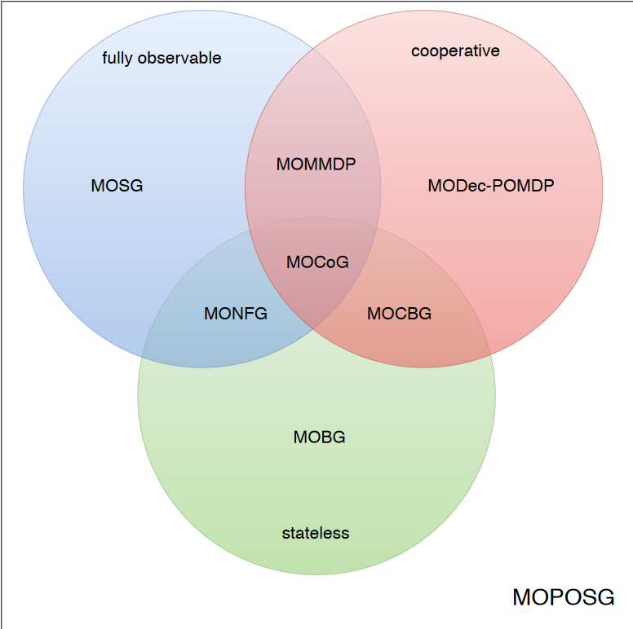
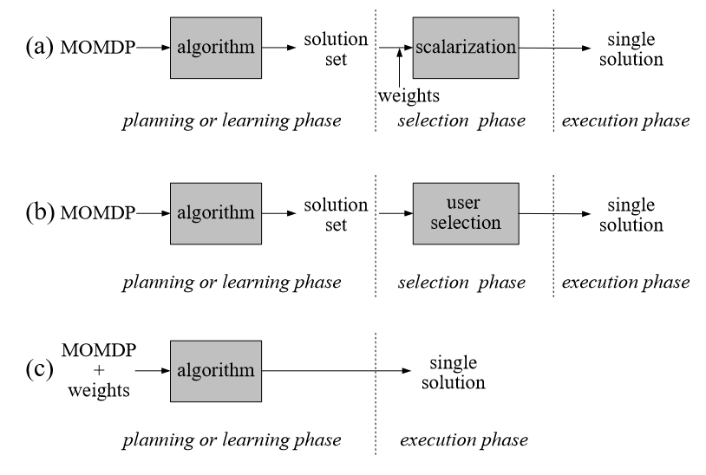
Types of multi-agent systems
Multi-Objective Normal Form Game (MONFG)
Multi-Objective Stochastic Game (MOSG)
Multi-Objective Bayesian game (MOBG)
Multi-Objective Multi-agent Markov Decision Process (MOMMDP)
Multi-Objective normal form game (MONFG),
Multi-Objective Collaborative Bayesian game (MOCBG)
Multi-Objective Coordination Graph (MOCoG)
…
Cooperative
Shared reward problem
Coordination problem
Competitive
Zero-Sum games
Individual opposing rewards
Minimax equilibria
Mixed
General-Sum games
Nash Equilibria
multi-objective partially observable stochastic game (MOPOSG)
source: [Radulescu et al. 2019]
Whiteson, S., 2020, Factored Value Functions for Cooperative Multi-Agent Reinforcement Learning
Radulescu, R., et al., 2019, Multi-Objective Multi-Agent Decision Making: A Utility-based Analysis and Survey, Arxiv 1909.02964
Roijers, D.M., et al., 2013, A survey of multi-objective sequential decision-making. Journal of Artificial Intelligence Research 48, 67–113
source: [Roijers et al. 2013]
Notes:
Radulescu, R., 2019, Multi-Objective Multi-Agent Decision Making: A Utility-based Analysis and Survey, https://arxiv.org/pdf/1909.02964.pdf

Slide 3
Naïve Approach: treat others as part of the environment
Independent Q-Learning [Tan 1993]
Each agent learns independently with its own Q-Function
Independent Actor-Critic [Foester et al. 2018]
Each agent learns independently with its own actor-critic
Speed learning with parameter sharing
Different inputs, including action space, which induce distinct behavior
However, still independent – value functions condition only on T^a and u^a
Treats other agents as part of the environment
Limitations:
Non-stationary in learning
Hard to learn to coordinate
Prevent us from studying
Transfer Learning as means to Robustness
Foerster, J., et al., 2018, “Counterfactual multi-agent policy gradients." Proceedings of the AAAI conference on artificial intelligence. Vol. 32. No. 1. 2018.
Tan, M., 1993, "Multi-agent reinforcement learning: Independent vs. cooperative agents." Proceedings of the tenth international conference on machine learning. 1993.

Slide 4
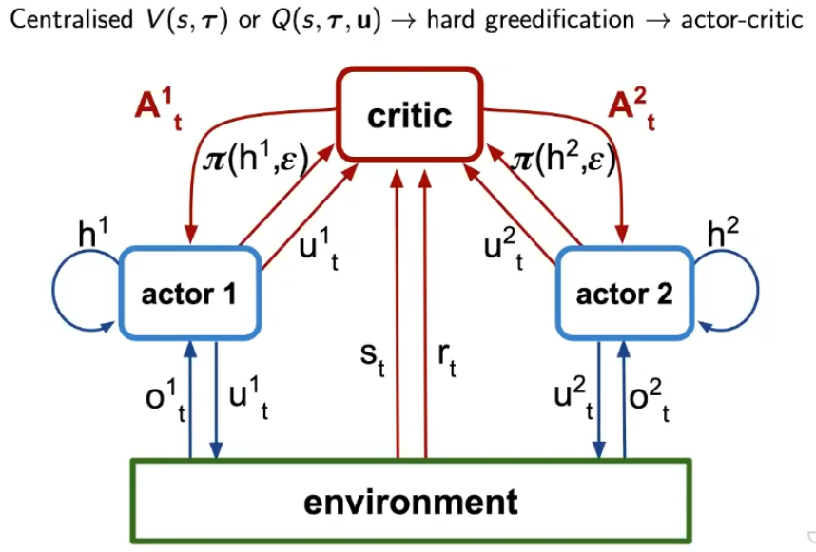
Centralized Critics [Foerster 2018]
Caveat:
Centralized makes harder to developed decentralized policies
Solution: Factorized the Value Function
Foerster, J., et al., 2018, “Counterfactual multi-agent policy gradients." Proceedings of the AAAI conference on artificial intelligence. Vol. 32. No. 1. 2018.

Slide 5
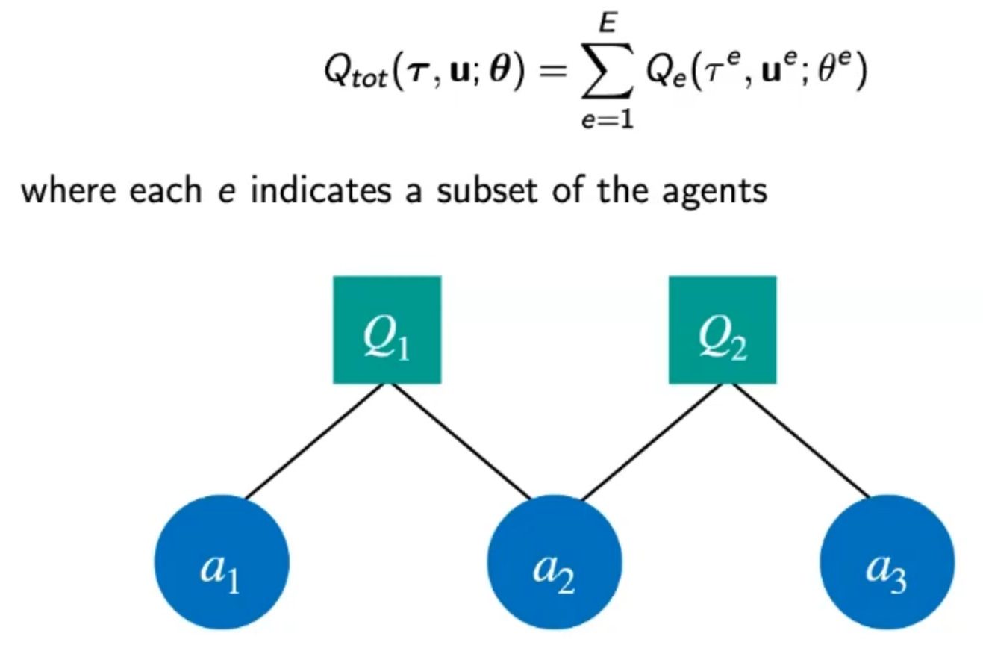
Factored Value Functions [Gestrin 2003]
Guestrin, Carlos, et al. "Efficient solution algorithms for factored MDPs." Journal of Artificial Intelligence Research 19 (2003): 399-468.

Slide 6
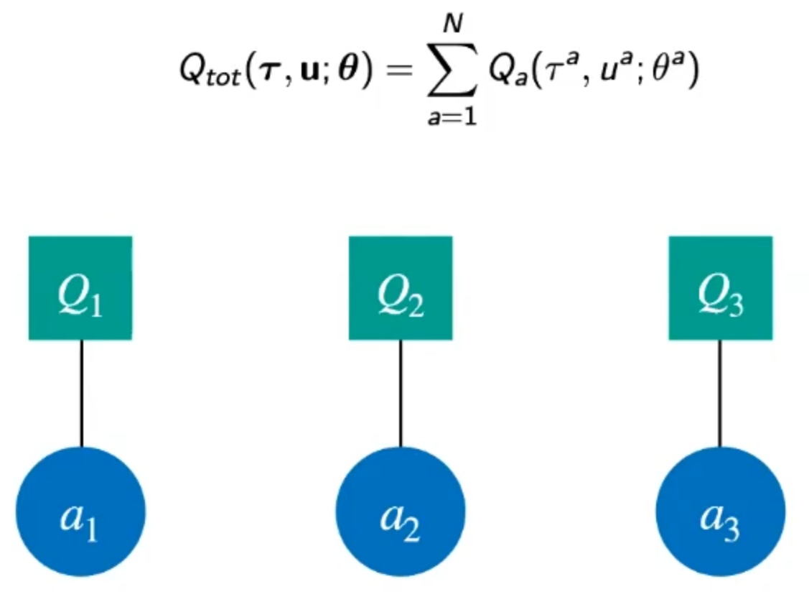
VDN – Value Decomposition Network [Sunehag 2017]
One Factorization per Agent
Advantage:
Allows to use Q-Learning instead of Actor-Critic
Sunehag, P., et al., 2017, “Value-Decomposition Networks For Cooperative Multi-Agent Learning Based On Team Reward.” In Proceedings of the 17th International Conference on Autonomous Agents and Multiagent Systems
Su, J., et al., 2021, "Value-decomposition multi-agent actor-critics." Proceedings of the AAAI Conference on Artificial Intelligence. Vol. 35. No. 13. 2021.
Notes:
https://youtu.be/W_9kcQmaWjo?t=2061

Slide 7
Factored Value Functions [Gestrin 2003]

Slide 8
VDN – Value Decomposition Network [Sunehag 2017]
One Factorization per Agent
Advantage:
Allows to use Q-Learning instead of Actor-Critic
Notes:
https://youtu.be/W_9kcQmaWjo?t=2061

Slide 9
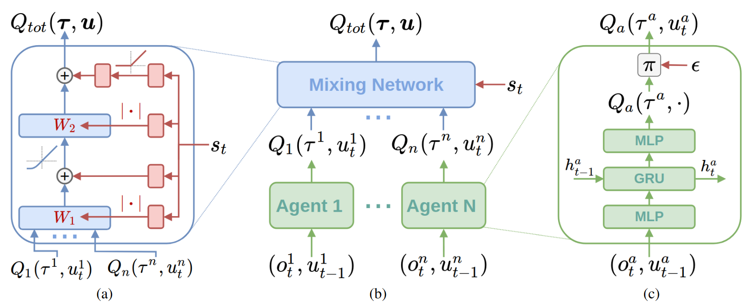
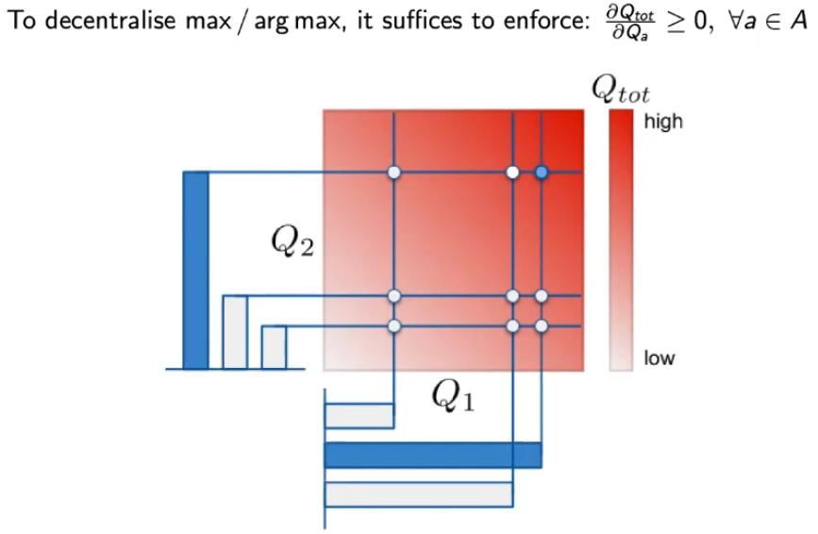
Qmix [Rashid 2018]
produce the weights and biases
Mixing network structure.
- In red are the hypernetworks that produce the weights and biases for mixing network layers shown in blue.
(b) The overall QMIX architecture.
(c) Agent network structure
Rashid, T., et al., 2018, QMIX: Monotonic Value Function Factorisation for Deep Multi-Agent
Notes:
Rashid, T., et al., 2018, QMIX: Monotonic Value Function Factorisation for Deep Multi-Agent

Slide 10
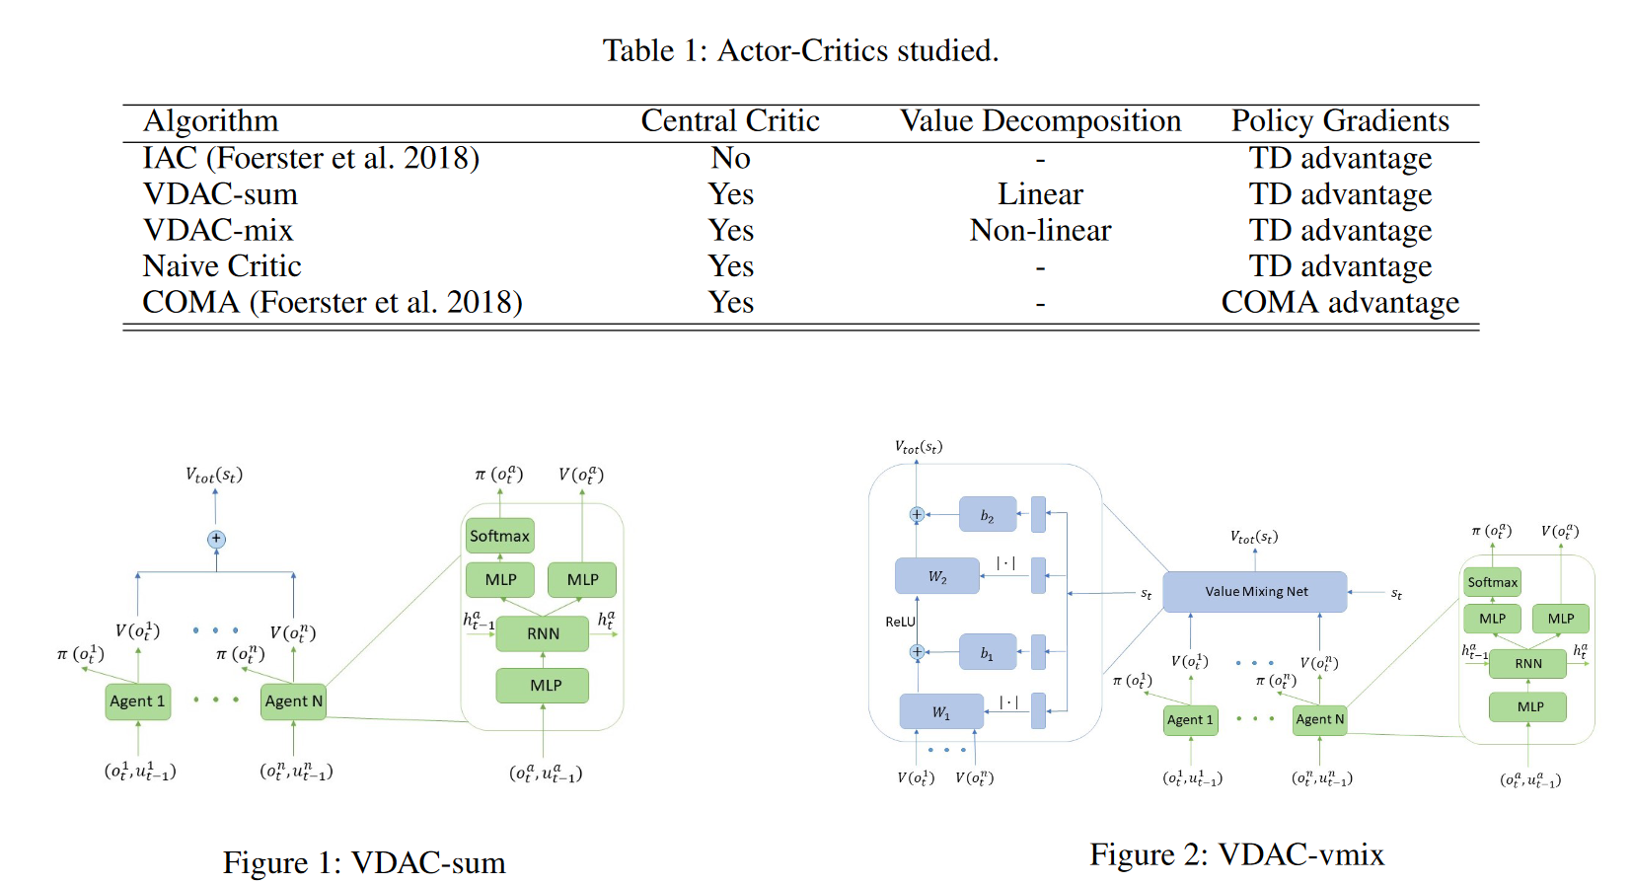
VDCA [Su et al. 2021]
VDAC is a policy-based method that decomposes global state-values
Meanwhile, QMIX and VDN decompose global action-values, i.e., belong to the Q-learning family.
Su, J., et al., 2021, "Value-decomposition multi-agent actor-critics." Proceedings of the AAAI Conference on Artificial Intelligence. Vol. 35. No. 13. 2021.
Notes:
VDAC is a policy-based method that decomposes global state-values
Meanwhile, QMIX and VDN decompose global action-values, i.e., belong to the Q-learning family.

Slide 11
Project

Slide 12
Preliminary Assumptions
Agents cooperate toward maximizing the total utility of the system (single objective)
Agents are perturbed individually w.r.t. the distribution of failures patterns (independence mechanism / modularity)
Agents have a partial observability of the environment (POMDP)
Agents share same graph model of shop component architecture (Same invariants, MDP skeleton?)
Same Failure Types, Actions, and Utility Functions

Slide 13
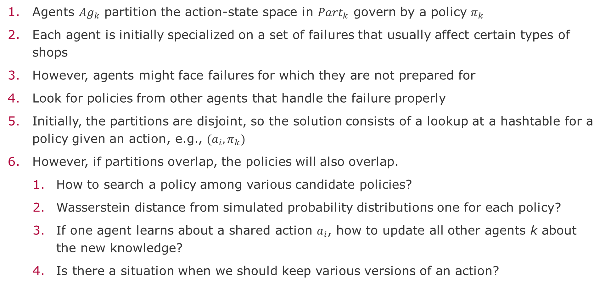
Design of the Share State Space
Agents $Ag_{k}$ partition the action-state space in $Part_{k}$ govern by a policy $π_{k}$
Each agent is initially specialized on a set of failures that usually affect certain types of shops
However, agents might face failures for which they are not prepared for
Look for policies from other agents that handle the failure properly
Initially, the partitions are disjoint, so the solution consists of a lookup at a hashtable for a policy given an action, e.g., $(a_{i},π_{k})$
However, if partitions overlap, the policies will also overlap.
How to search a policy among various candidate policies?
Wasserstein distance from simulated probability distributions one for each policy?
If one agent learns about a shared action $a_{i}$, how to update all other agents k about the new knowledge?
Is there a situation when we should keep various versions of an action?

Slide 14
References - MARL
Critiques
Hernandez-Leal, P., et al., 2018, Is multiagent deep reinforcement learning the answer or the question? A brief survey. learning 2122.
Hernandez-Leal, P., et al., 2020, A very condensed survey and critique of multiagent deep reinforcement learning. Proceedings of the 19th International Conference on Autonomous Agents and Multi-Agent Systems.
Gronauer, S. & Diepold, K., 2021, Multi-agent deep reinforcement learning: a survey. Artificial Intelligence Review, pp.1-49.
Vithayathil V., et al., 2020, A survey of multi-task deep reinforcement learning. Electronics 9.9.
Zhang, K., et al., 2021, Multi-agent reinforcement learning: A selective overview of theories and algorithms. Handbook of Reinforcement Learning and Control, pp.321-384.
Nguyen, T. T., et al., 2020, Deep reinforcement learning for multiagent systems: A review of challenges, solutions, and applications. IEEE transactions on cybernetics 50.9, pp.3826-3839.
Du, W. & Ding, S.., 2021, A survey on multi-agent deep reinforcement learning: from the perspective of challenges and applications. Artificial Intelligence Review 54.5, pp.3215-3238.
Rădulescu, Roxana, et al., 2020, Multi-objective multi-agent decision making: a utility-based analysis and survey. Autonomous Agents and Multi-Agent Systems 34.1, pp.1-52.
Zafar, H., et al., 2021, Transfer Learning in multi-agent reinforcement learning with double Q-Networks for distributed resource sharing in V2X Communication. arXiv:2107.06195.
Lopez-Cot, S., 2020, Learning to teach in multiagent reinforcement learning with teams of N> 2 Agents. Diss. Massachusetts Institute of Technology.
Hejazi, E., 2021, Multi-agent machine learning in self-organizing systems. Information Sciences 581, pp.194-214.
Surveys
Applications

Slide 15
End

